Slide 1

AI4Research Workflow
How a research request becomes checked evidence, what is still hard, how that compares with the state of the art, and where it runs next
Muk Chunpongtong · September 2026
Notes:
TIME 0:25
SAY: This is the AI4Research workflow: how a research request becomes checked evidence, what is still hard, how that compares with the state of the art, and where it runs next. The capsule talk after this one builds on 2 things from here: the freeze and the task graph.

Slide 2
1 GOAL
3 claims: the freeze, checking, and the runtime
• The talk: the workflow stage by stage, what has been shown so far, what is still hard, then the other systems and the platform it moves to
• The freeze is the 1 boundary that matters: the plan, its capabilities and the rules that will grade it are hashed before anything runs
• Published research agents generate well and check weakly; AI4Research checks strictly and generates little
• DeepSeek Harness supplies the runtime AI4Research built by hand; the contract layer is what AI4Research adds
• Everything up to the challenges is code read in source at commit b0bf165f9; the next steps are proposed
Report §1
2
Notes:
TIME 1:00
SAY: The talk goes through the workflow stage by stage, then what has been shown so far, then what is still hard, and only then the other systems and the platform we move to. 3 claims run through it. First, the freeze is the one boundary that matters: before anything runs, the plan, the capabilities it uses and the rules that will grade it are hashed together. Second, published research agents are good at generating and weak at checking, and AI4Research looks like the opposite, though nothing outside the repository has measured it yet. Third, DeepSeek Harness gives us the runtime we built by hand, and what we add is the contract. Everything up to the challenges I read in the source at commit b0bf165f9; the next steps are proposals.

Slide 3
1 SYSTEM
What AI4Research is, in 7 terms
Term | Meaning
request → result | a research request in plain language goes in; checked evidence and a report come out
capsule | 1 capability, described in a YAML file: what it takes in, what it produces, what it may touch. 79 exist, all written by hand
plan, node | the plan is a graph of steps; a node is 1 step, with 1 capsule bound to it
operator | what actually does a step: a model call, a coding agent or a tool
gate | a check that decides PASS or FAIL for 1 node's output
sprint | 1 request, from the moment it arrives to the finished report
freeze | the moment the plan, its capsules and the rules that will grade it are hashed into 1 contract; after it, nothing in the plan can change
Report §1, Table 1; harness/config at b0bf165f9
3
Notes:
TIME 1:05
SAY: AI4Research takes a research request written in plain language and turns it into checked evidence and a report. 7 terms carry the talk. A capsule describes 1 capability in a YAML file: what it takes in, what it produces and what it may touch; 79 exist and every one was written by hand, which is what the next talk is about. The plan is a graph of steps, and a node is 1 step with 1 capsule bound to it. An operator is what actually does the step: a model call, a coding agent or a tool. A gate decides pass or fail for 1 node's output. A sprint is 1 request from start to finish. And the freeze is the moment the plan, its capsules and its grading rules are hashed into 1 contract, after which nothing in the plan can change.
IF ASKED:
- The design target, translated from Chinese: models interpret meaning; deterministic code validates structure, maintains references, freezes contracts and schedules. It is a target, not a measurement
- Counts: 45 logical operators (roles the plan names), 102 physical operators (63 enabled); 80 registry entries, of which 77 are capabilities, 1 a guard and 2 resources; 74 of the 79 capsule files are registered

Slide 4
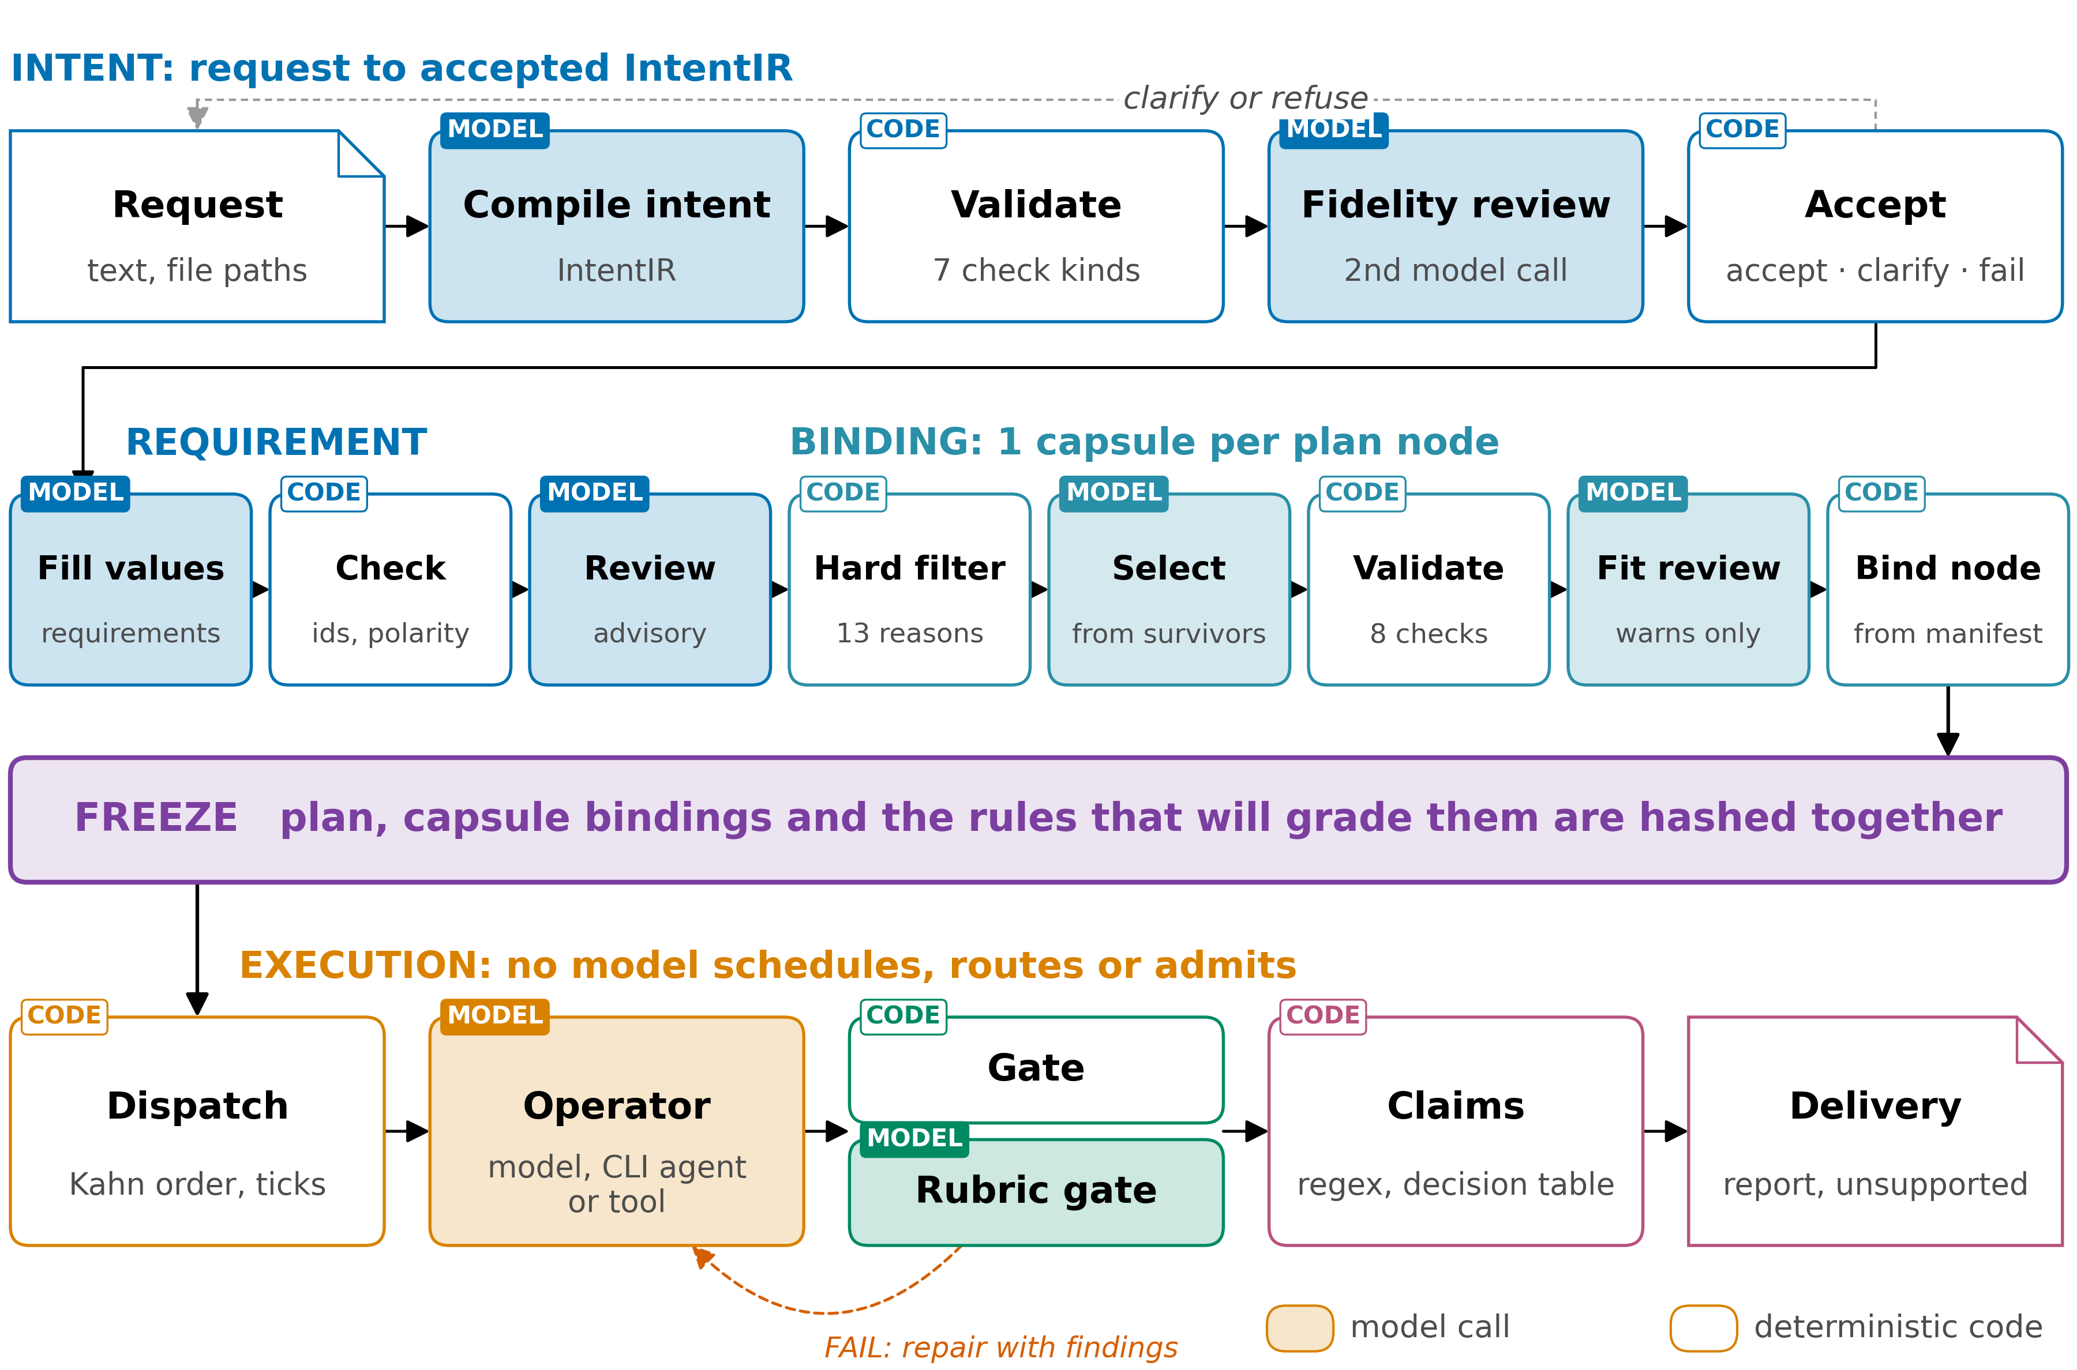
2 WORKFLOW
Models propose, code checks, the freeze fixes rules
Report §2, Fig. 1
4
Notes:
TIME 1:00
SAY: Here's the whole pipeline. Colour is the stage, a tinted box is a model call and a white box is code. Above the purple freeze band, every model call is followed by code that checks it: the model compiles the request and code validates it, the model fills in the requirements and code checks them, the model picks capsules and code validates the picks. At the freeze, the plan, its capsules and its grading rules are hashed together. Below the freeze, no model decides what runs next, where it runs or whether a result is accepted. Models still do the work inside steps and still judge inside some gates, and a failed gate sends the step back for repair with the findings, up to the step's repair budget.
IF ASKED:
- 20 of the 43 registered checks are rubrics a model judges; scheduling, routing and admission are code

Slide 5
2 WORKFLOW · REQUEST AND REQUIREMENTS
Before the plan, code checks every model output
IN the request text and its attachments OUT an accepted record of the request, and a requirement contract
Step | Author | What it does
compile the request | model | a structured record of what was asked: goals, wanted outputs, constraints, open ambiguities
check it | code | 7 kinds of check; every quote the model made must be found in the request text
review it | 2nd model | does the record reflect the request? 1 repair by default, at most 4
fill the requirement contract | model | the model fills in values; the goals and checks it may name come from fixed lists
check the contract | code | constraints copied word for word; every goal is covered
THUS every model output is checked by code before the plan is built
Report §2.1, Table 2; intent_compiler.py:1368, :782, :1272; template_contract.py:55; semantic.py:47
5
Notes:
TIME 0:55
SAY: The request becomes a structured record of what was asked. The model quotes the request, and code finds every quote, so the record can't point at text that isn't there. A second model checks that the record reflects the request, and in the 14-node run it caught the compiler turning 'distinguish 5 evidence statuses' into 'only these 5'; 1 repair fixed it. Then the model fills in the requirement contract, but the goals and checks it may name come from fixed lists, so it can't invent a check. Of the 43 registered checks, 20 are rubrics a model judges and 23 are code.
IF ASKED:
- After the repair budget, an objection from the review model becomes a warning, so a review model never becomes a second admission gate
- Nearest design: PlanCompiler (arXiv 2604.13092), 44 of 50 schema-trap tasks against 20 of 50 for GPT-4.1, not applied to research workflows
- The requirement stage makes at most 3 model calls and 1 structural repair; its reviewer is advisory

Slide 6
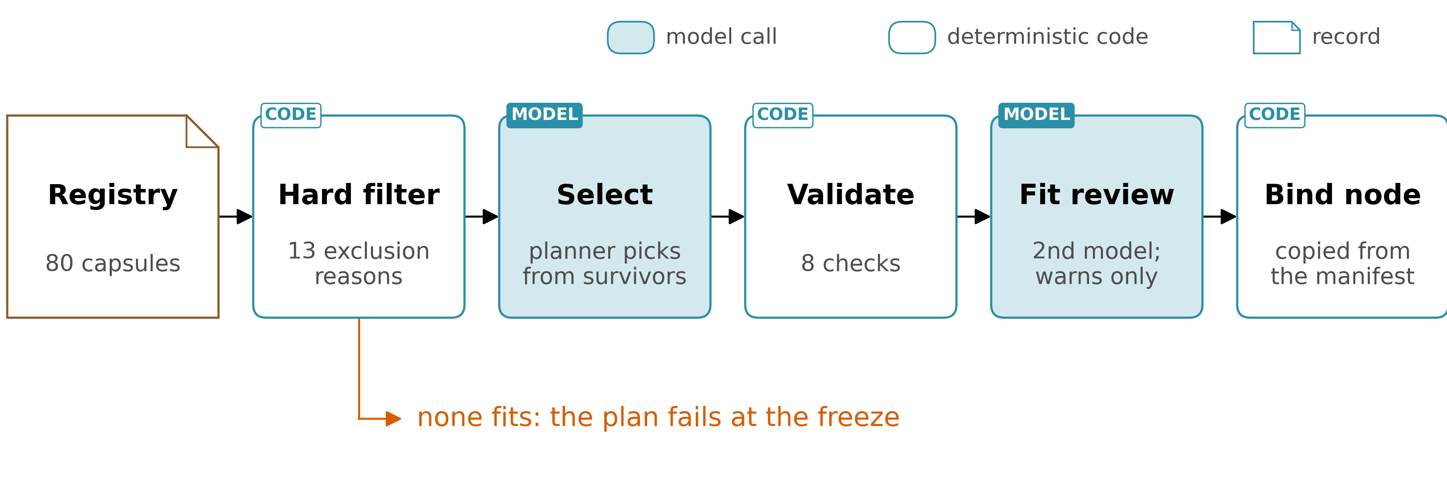
2 WORKFLOW · BINDING
Code narrows, a model picks, and code checks the pick
IN requirements, capsule registry, operators OUT a plan with a capsule bound to every node
THUS the model picks only among capsules code admitted; if none fits, the plan fails
Report §2.2, Fig. 2; elastic_planner.py :4553, :4727, :4815, :5685, :6270-6320; apo_plan_compiler.py:626
6
Notes:
TIME 0:55
SAY: Binding gives each step a capsule. Before any model sees the list, code removes every capsule that can't do the step, for 13 reasons: wrong input or output types, effects the step didn't ask for, network rules, no way to verify it, too little trust. The planner model picks from what's left, code checks the pick 8 ways, and a second model reviews the fit but can only warn. What gets written into the plan is copied from the capsule's own file, never from the model. And if nothing fits a step, the whole plan fails before anything runs. The capsule talk picks that up.
IF ASKED:
- Effects in both directions: the capsule must have every effect the node needs and none it did not request
- The fit reviewer can be the same model as the planner, and the record says so
- Nearest substitutes today: a direct answer to the whole request, coding-agent capsules, composition through registered adapters

Slide 7
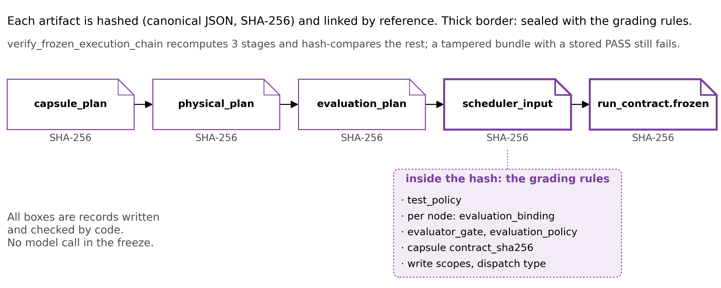
3 FREEZE
Grading rules are hashed with the plan
IN the bound plan and its grading rules OUT 1 hash over the plan and the rules that will grade it
Change 1 number in a frozen plan and verification fails, even though the stored verdict still says PASS.
Once a plan runs it cannot change: a plan that turns out wrong runs to the end, and the user resubmits.
THUS changing what counts as success after the outputs are seen breaks the contract
Report §2.3, Fig. 3; elastic_planner.py:6802-6842, :7748-8052; test_elastic_planner.py:4697-4718
7
Notes:
TIME 1:10
SAY: The freeze is 8 steps of code, with no model. First it turns the checking budget into a test policy, which says how much checking each step gets, so the grading rules exist before anything is sealed. Then each piece of the plan is hashed and linked, and the thick boxes are the grading rules: the test policy and each step's gate. If those sat outside the hash, a run could be graded by rules chosen after its outputs were seen. This is tested: change 1 number in a frozen plan and verification fails, even though the stored verdict still says pass. A hash detects an edit after the fact; it doesn't prevent one, and it doesn't say who made it. If any of the 8 steps fails there's no re-plan: the user resubmits. And once the plan runs it can't change, so a plan that turns out wrong runs to the end.
IF ASKED:
- Verification recomputes 3 stages and hash-compares the rest
- If a capsule definition changes during planning, the freeze aborts with CAPSULE_CHANGED_DURING_PLANNING
- Nearest work: CaMeL (arXiv 2503.18813) fixes control flow, PlanCompiler a typed graph, Rel(AI)Build (arXiv 2606.26924) hashes its specification; a search on 2026-09-13 found no reviewed system that seals its own evaluation criteria in the run hash
- Arbor and Kosmos re-plan every cycle; this design trades that away for grading rules fixed in advance

Slide 8
3 FREEZE · RELATED WORK
Other work fixes the plan, never the rules that grade it
System | Fixed before execution | Not fixed
CaMeL (2503.18813), plan-then-execute security | Control flow, before untrusted data is read: 77% of AgentDojo tasks solved with provable security, against 84% undefended | Success criteria
PlanCompiler (2604.13092), compiled pipelines | A statically validated typed graph | Evaluation policy
Rel(AI)Build (2606.26924), deterministic control plane | The specification, content-hashed at approval, plus install gates, blocklists and phase transitions | Which files and tests satisfy each criterion, declared during implementation and audited afterwards
AI Scientist-v2, Kosmos, Arbor, openJiuwen auto_research | Nothing global: plans evolve every cycle or round | The plan and the rules that grade it
THUS no reviewed system seals its grading rules in the run hash (search of 2026-09-13)
Report App. D.4, Table D4; arXiv 2503.18813 p1; 2604.13092; 2606.26924 p1, p20
7a
Notes:
INSERT: optional slide; delete or hide it and the talk flows unchanged
TIME 0:45
SAY: Three families of work fix something before execution, and none of them fixes what will grade the run. CaMeL fixes control flow before any untrusted data is read, solving 77% of AgentDojo tasks with provable security against 84% undefended, and says nothing about success criteria. PlanCompiler fixes a statically validated typed graph and leaves the evaluation policy open. Rel(AI)Build content-hashes its specification at approval, and the agent declares during implementation which files and tests satisfy each criterion. The research agents fix nothing global.
IF ASKED:
- Rel(AI)Build calls its own test linkage cooperative and auditable after the fact, not enforced before execution (arXiv 2606.26924 p1, p20)
- CaMeL's 77% is AgentDojo tasks solved with provable security, against 84% for the undefended baseline (arXiv 2503.18813 p1)
- A hash detects an edit after the fact wherever something recomputes it; it prevents none and authenticates no author (Report §2.3)

Slide 9
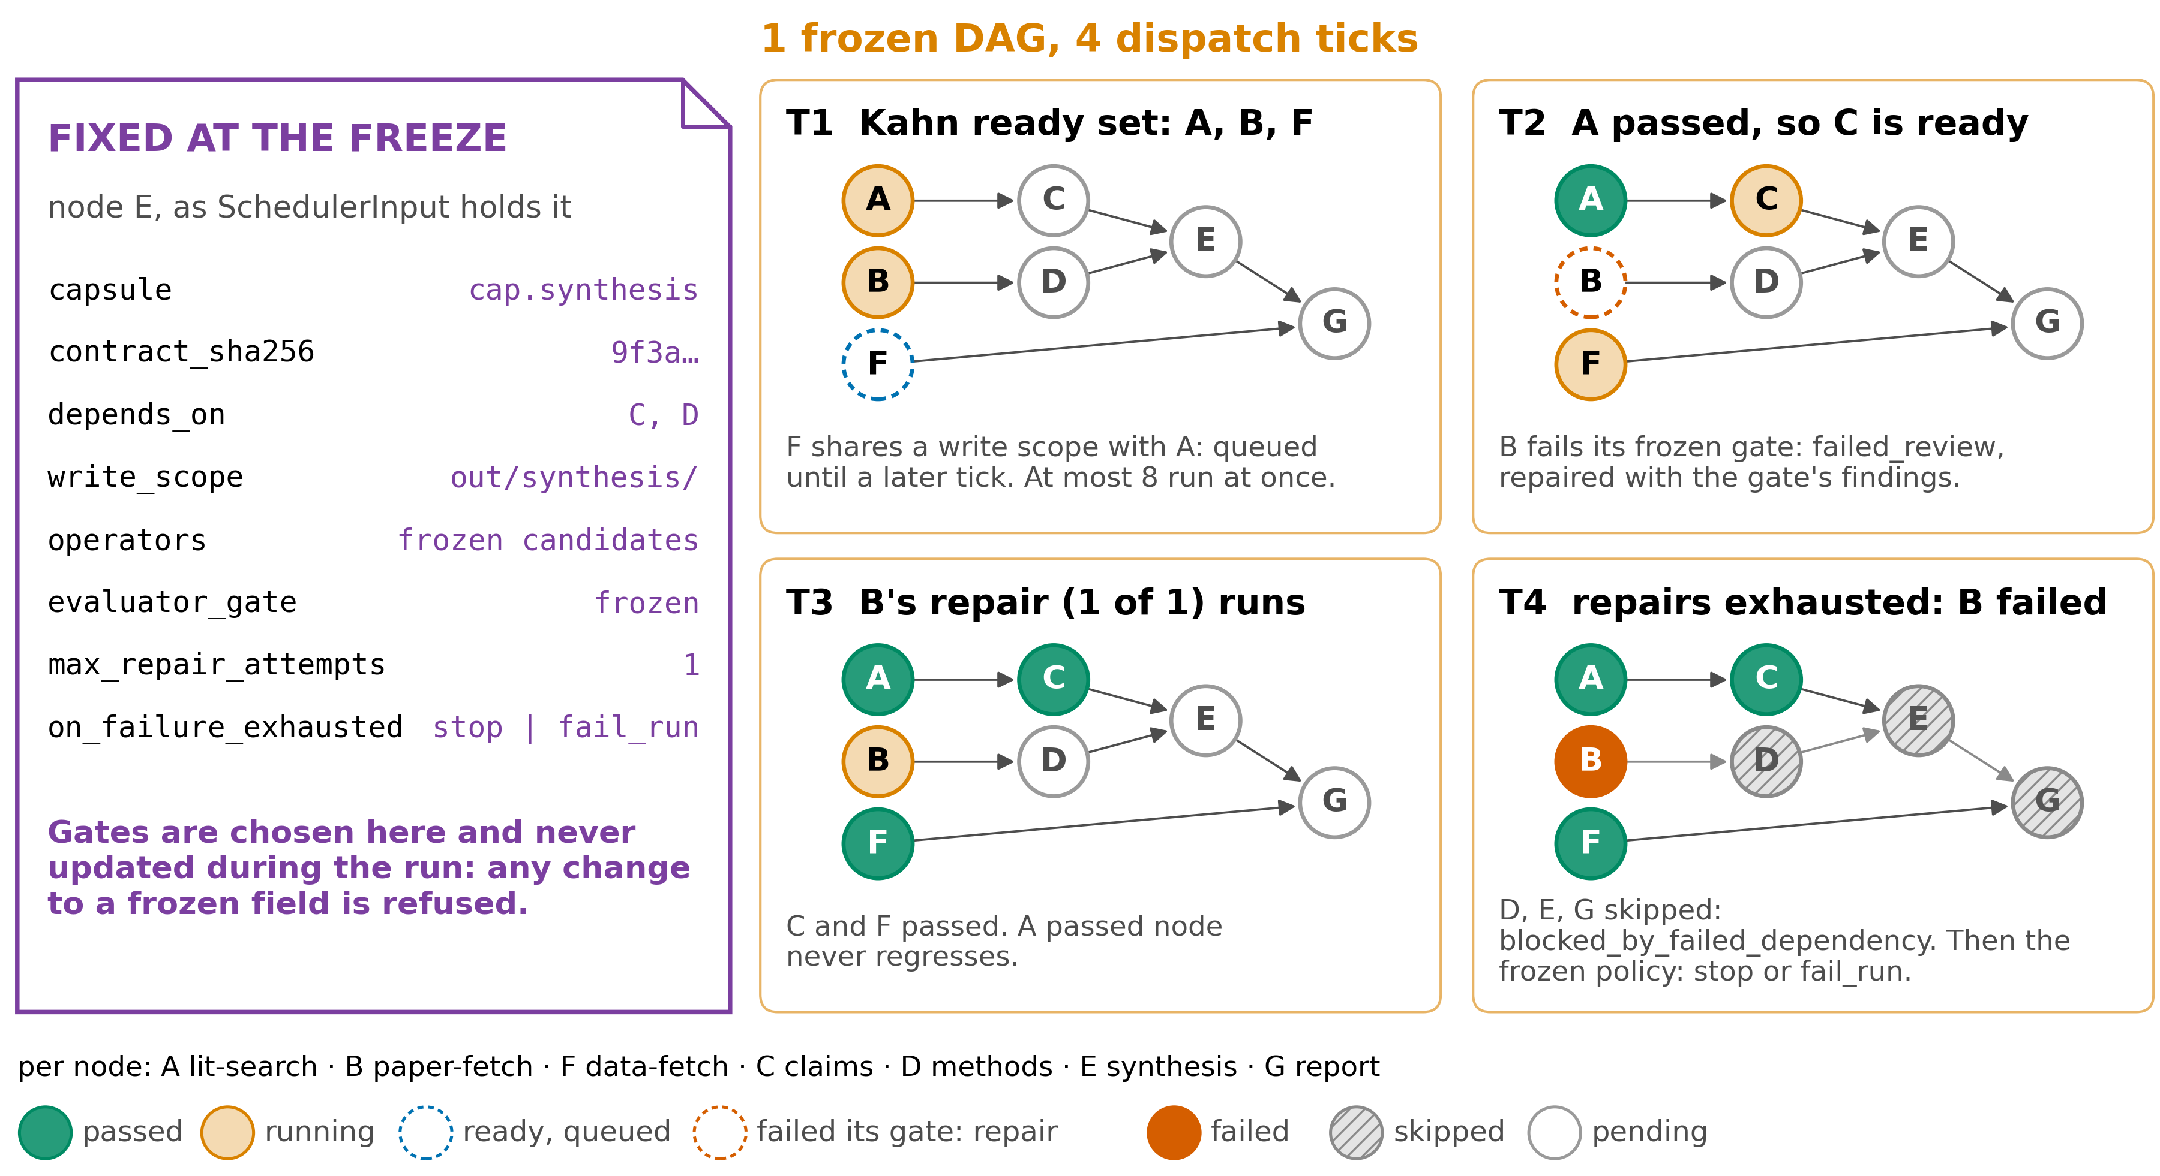
4 EXECUTION
A failure stays contained; gates never move
Report §2.4, Fig. 4; graph_scheduler.py :2008, :2179, :3200-3209, :3979; scheduler_input.py:849
8
Notes:
TIME 1:05
SAY: Execution runs in rounds, called ticks, and every step of a tick is code. The only thing that changes is the ledger, the record of what has happened so far. On the left is what the freeze fixed for step E, including its gate, and nothing on that card can change during the run. Walking the ticks: at T1, A, B and F are ready because everything they depend on has passed, but F writes to the same files as A, so it waits. At T2, A has passed, so C is ready, and B fails its frozen gate and goes back for repair with the findings. At T3, B's 1 repair runs. At T4 it fails again, so B is failed, and D, E and G, which depend on it, are skipped.
IF ASKED:
- A tick is 6 steps: lock the graph and refuse if a guard fails, reconcile earlier dispatches, apply approval and the terminal barrier, verify the runtime projection and build the ready set, admit and lease, save the ledger (Report App. D.5)
- The ready set is built in 4 steps: dependency order with ties by id, keep the nodes whose dependencies all passed, order by priority then id and take up to 8, and hold back a write conflict to a later tick (Report §2.4)
- A node waiting for human review holds its dependents pending instead of skipping them
- Each unit of work is fingerprinted, so a retry never repeats a paid call
- The graph is illustrative; the rules are the code's

Slide 10
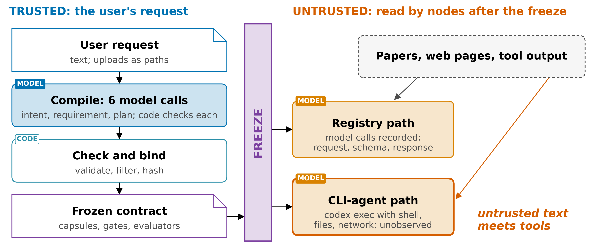
4 EXECUTION · TRUST
Nothing watches the coding-agent path
THUS untrusted text meets a shell, files and network only on the coding-agent path
Report §2.5, Fig. 5; research_operator_registry_adapter.py:268, :357; elastic_planner.py:1389-1392
9
Notes:
TIME 1:00
SAY: The user's request is trusted. Everything a step reads after the freeze is not: papers, web pages, tool output. The freeze fixes the plan before any of that is read. There are 2 ways a step can run. On the registry path, the recorded one, every model call is kept with its request, schema and response. On the coding-agent path, an agent gets a shell, files and network, and nothing records what it does, so that's where the general ability lives, and where the trust doesn't. A fixed plan also doesn't stop planted text from steering results: a sentence planted in a paper still passes the literature check. All of this holds for 1 user on 1 machine, and a shared unattended server needs a different trust model.
IF ASKED:
- A shared server needs the coding-agent path observed; challenge 5 proposes the sandbox logs the move to DeepSeek Harness would give (Report §6.1)
- CaMeL gives untrusted text only to a model with no tools

Slide 11
4 EXECUTION · GATES
A result does not say whether code or a model decided
IN a node's output OUT PASS or FAIL from the gates frozen for that node
Gate kind | Decides by | Note
run a command | the exit code (code) | a timeout counts as an infrastructure failure, not a FAIL
ask a model | a separate evaluator model | a judgment, not a rule
code change | patch + tests + a verifier | the verifier is never the writer
registered checks | 23 code gates, 20 model rubrics | a result does not say which kind decided
THUS a receipt that a step ran is not evidence: only a gate PASS closes a node
Report §2.6, Table 3; contract_gate_executor.py; verification_gate.py:13
10
Notes:
TIME 0:40
SAY: Every node closes on the gates frozen for it. Some run a command and decide by the exit code, and a timeout counts as an infrastructure failure, not a fail. Some send the output to a separate evaluator model. A code change needs a patch, tests and a verifier that isn't the writer. The weak point: a pass from a model rubric looks exactly like a pass from code in the results, and 20 of the 43 registered checks are rubrics.

Slide 12
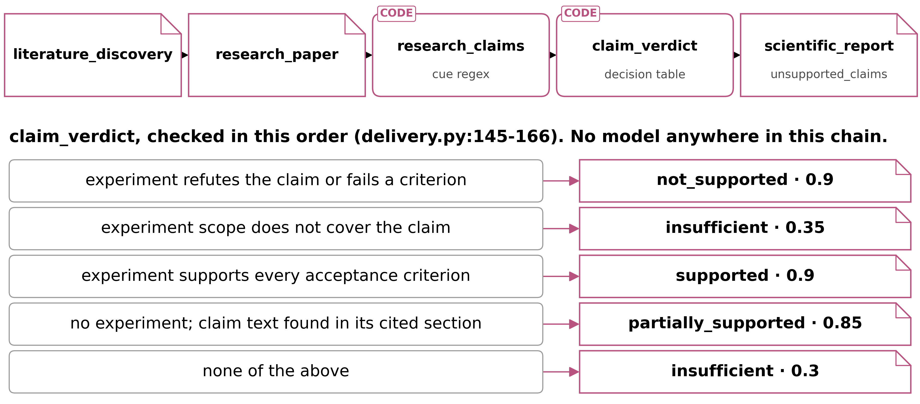
5 CLAIMS
No model extracts claims, and a verdict proves provenance
IN the paper sections kept for the run OUT a verdict per claim; conclusions with an evidence status
Without an experiment the best verdict is 'partially supported' at 0.85, and a claim judged insufficient still becomes a conclusion.
THUS the verdict says the sentence is in its cited section, not that it is true
Report §2.7, Fig. 6, Table 4; operators.py:1180-1265; delivery.py:145-166
11
Notes:
TIME 1:00
SAY: Claims are picked out of paper text by a word rule, words like 'improves' or 'found', not by a model. Each claim is then judged by this table, top to bottom. Take a real test case: 'Reranker A improves ranking quality over reranker B.' The word 'improves' matches, the sentence and its section are hashed, and there's no experiment, so the table stops at 'partially supported' with a confidence of 0.85. That verdict certifies that the sentence is in its cited section, so a wrong or retracted paper passes. That's provenance, not truth. A claim judged insufficient still becomes a conclusion in the report, so the list of unsupported claims stays empty. And a claim the word rule misses never appears anywhere, so nothing shows it was missed.
IF ASKED:
- Cue words match by prefix, so 'founded' counts as 'found', and any digit makes a claim testable, a year too
- A quoted span that no longer matches its hash is dropped silently; no gate reads the flag
- The report's conclusions are filtered on evidence ids rather than verdicts (delivery.py:256-261)
- The rules are English only

Slide 13
6 EXPERIMENTS
Experiment code is hand-written or unobserved
IN an approved plan with a hashed script and inputs OUT measured results, or lowest-class evidence
Path | Who writes the code, and what is checked | Evidence class
hand-written | a person writes the script; its code and inputs are hashed and approved before it runs; 1 family exists (KV-cache quantisation) | measured
coding agent | an agent writes and runs the code; nothing observes what it does | fixture-only, the lowest class
21 of the 79 capsule files declare a trust class, so most evidence carries no declared class.
THUS proposed: a model writes the script, and it runs only after its hash is approved
Report §2.8; cap.research-experiment-run.yaml; kv_cache_quantization_runner.py
12
Notes:
TIME 0:40
SAY: Experiments are the only place AI4Research measures instead of citing. On the hand-written path, a person writes the script, and its code and inputs are hashed into the approved plan, so it can't fabricate a measurement; but only 1 family exists, KV-cache quantisation. On the coding-agent path, an agent writes and runs the code: general, and unobserved. And only 21 of the 79 capsule files declare a trust class at all, so most of the evidence a run produces carries no declared class.

Slide 14
7 EVALUATION
1 run end to end, and 0 external scores
Evidence | Result
14-node run, 2026-09-03 | 14 nodes executed, 8 files delivered, every required gate passed
Test suite, 22 files | 606 passed · 34 failed · 8 skipped
End-to-end journey tests | 24; the only acceptance evidence
External benchmark scores | 0
THUS demonstrated end to end; an unattended run from a prompt alone has not finished
Report §3.1, Table 5; stabilisation log l.793-796, l.862; phase-22-journey-test-report.md
13
Notes:
TIME 0:40
SAY: What's been shown. A 14-node run on 3 September executed every node first time after 1 bounded repair of the request record, delivered its 8 files and closed with every required gate passed. The test suite has 34 failures, kept as known debt rather than relaxed away. The 24 end-to-end journey tests are the only acceptance evidence. So it works end to end, an unattended run from a prompt alone has not finished, and nothing outside this repository has ever measured it.
IF ASKED:
- Passing-flag counts are not a reliable measure here, so no run count is quoted
- NOT_TESTED and ENVIRONMENT_BLOCKED are not FAIL
- An adapter for Terminal-Bench 2.0 exists, but there is no score

Slide 15
8 CHALLENGES
No outside score, and a verdict that stops at provenance
§6.1 | Challenge | Evidence | What would settle it
1 | Nothing outside this repository has scored it | 0 benchmark scores; the 24 journey tests are internal; whatever the risk level, exactly 1 node of a plan gets a model evaluator, and results never say which PASS a model decided | Run TruthInsightBench end to end and read its 6 dimensions; record on every verdict which kind of check decided it
2 | A verdict proves provenance, and only in English | Without an experiment the best verdict is a case-insensitive text match, 0.85; a quote that no longer matches its hash is dropped and no gate notices, so the list of unsupported claims is always empty | Fail the node when a quote fails its hash; filter the report on the verdict; a model extractor bound to quotes, tested per language
Report §6.1, Tables 9 and 10; evaluation_budget.py:22; delivery.py:155, :201
14
Notes:
TIME 0:45
SAY: What is still hard, starting with what a result means here. Nothing outside this repository has ever scored the system: no benchmark scores, journey tests that are internal, and inside a run exactly one node of the plan gets a model evaluator, whatever the risk level, with nothing in the results saying which passes a model decided. Second, without an experiment a verdict proves the sentence sits in the cited section and stops at 0.85, and a quote that no longer matches its hash is dropped quietly. Both fixes are proposed.
IF ASKED:
- Human review is not the fallback: experts judge verifiable claims correctly 60.8% of the time
- The English rules sit in the negation cues and clause breaks of the request, and in the claim cues and testability rules for papers
- 20 of the 43 registered checks are model-judged rubrics, and the result vocabulary does not separate them from the 23 Python gates
- A Terminal-Bench 2.0 adapter already exists; TruthInsightBench needs one of the same shape

Slide 16
8 CHALLENGES
A frozen plan gets 1 repair, and a run needs a person
§6.1 | Challenge | Evidence | What would settle it
3, 4 | A frozen plan gets 1 repair and no recovery | 1 repair by default, then the sprint fails; every node but the 1 evaluated one is frozen with no evaluator gate, so an outcome nobody wrote a rule for records a pass; a node no capsule fits fails the plan | Count defects per plan over the 24 journeys; let the test policy say halt, inconclusive or ask a person
5, 6 | A run is recorded, not observed, and stops without a person | On the coding-agent path, commands, files and network are unobserved; 21 of 79 capsule files declare a trust class; after a rate-limit error (HTTP 429), a frozen 1-attempt policy ended a run and cancelled 13 nodes | Move to DeepSeek Harness, whose sandbox logs what runs; declare a hash-bound local-source fallback; 1 unattended journey from a prompt
Report §6.1, Tables 11 and 12; intent_compiler.py:210-217; apo_plan_compiler.py:626; log l.814
15
Notes:
TIME 0:45
SAY: Then what a run does. A frozen plan gets one repair before the freeze, then the sprint fails, and every node except the evaluated one is frozen with no evaluator gate, so an outcome nobody wrote a rule for closes as a pass. When execution shows the plan was wrong there is no re-planning, and the request goes back in. A run is also recorded rather than observed: on the coding-agent path commands, files and network go unwatched, and one frozen attempt cancelled 13 nodes after a rate-limit error. Both fix lists are proposed.
IF ASKED:
- A coordinator once ran code 28 hours older than the file on disk; that substrate is what the move to DeepSeek Harness replaces
- The node's network rule is spent filtering capsules at planning; nothing watches the network at run time
- 13 of PlanCompiler's 22 failures routed around typed contracts; this system's own defect rate is unmeasured
- Keeping the freeze trades away the re-planning Arbor and Kosmos do every cycle

Slide 17
8 CHALLENGES · WHAT WOULD SETTLE THEM
What would settle each challenge, and what to read
Challenge | The test | The signal
1 Nothing measured externally | Run TruthInsightBench end to end on 1 frozen model | Each of the 6 dimension scores read on its own, not the total
2 Provenance, not truth | Add a gate on the failed quote, then replay the delivery test with 1 quote edited | Whether the node fails, or passes with the quote dropped
3 The freeze and the unforeseen | Freeze a plan, then deliver, for a node with no evaluator gate, an output that fits its schema and contradicts its acceptance criterion | The verdict recorded: a pass measures the gap, a failure closes it
4 A wrong plan, no recovery | Replay the 24 journey requests through planning alone at 1 frozen model | Defects per plan, against the 0 the freeze assumes
5 Recorded, not observed | Run 1 experiment node on the coding-agent path with an outbound request placed in the script | Whether any artifact the run keeps shows the call
6 Unattended runs stop | 1 unattended journey from a prompt alone, with the provider forced to return a rate-limit error | Whether the run continues on declared local sources or cancels its downstream nodes
Report §6.1, Tables 9-12; §3.2
15a
Notes:
INSERT: optional slide; delete or hide it and the talk flows unchanged
TIME 0:55
SAY: Each challenge has a test that would settle it. Run TruthInsightBench end to end on 1 frozen model and read each of the 6 dimensions on its own. Add a gate on the failed quote, replay the delivery test with 1 quote edited, and see whether the node fails. Freeze a plan, deliver an output that fits its schema and contradicts its acceptance criterion, and read the verdict. Replay the 24 journey requests through planning alone and count defects per plan. Put an outbound request in a script on the coding-agent path and look for it in the artifacts. Force a rate-limit error on an unattended run and see whether it continues on local sources.
IF ASKED:
- An evidence-auditability rate inside the published 78% to 81% band puts the auditability claim with the field rather than ahead of it (Report §3.2, §6.1)
- A Terminal-Bench 2.0 adapter already sits in the repository, and TruthInsightBench needs 1 of the same shape (Report §6.1)
- Hand-labeling the claims of 50 paper sections would give the cue-word rule's recall (Report §6.1, Table 9)

Slide 18
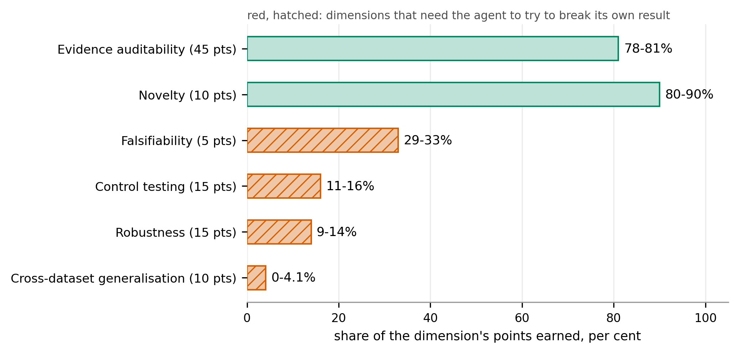
9 STATE OF THE ART
First external test: 11% to 16% on control testing
DEMONSTRATED BY TruthInsightBench (arXiv 2609.05079) · 40 blind tasks, 4 coding agents, 1 base model
Totals do not separate the agents (58.4 to 60.3, smallest p = 0.118), so the first external run should report each dimension.
Report §3.2, Fig. 7; arXiv 2609.05079 p1, p3, p8, p12, p14
16
Notes:
TIME 0:35
SAY: Challenge 1 said nothing has scored the system. This is the first external test worth running, because what it scores is verification. The 4 agents earn most of their points for auditability and novelty, and almost none for the dimensions that need them to break their own result: 11 to 16% on control testing. Their totals sit inside 2 points of each other, so the first run should report every dimension on its own.
IF ASKED:
- A frozen model judge applies the rubric to executed artifacts; no instance is graded by a human
- 40 blind tasks from 40 peer-reviewed studies across 10 domains
- Points: evidence auditability 45, robustness 15, control testing 15, cross-dataset generalisation 10, novelty 10, falsifiability 5

Slide 19
9 STATE OF THE ART
4 reference systems generate well and check weakly
The 4 systems span the design space: generation first, scale, a held-out check, and the same thesis.
System | Plans how | Checks with | Headline result
AI Scientist-v2 (arXiv 2504.08066) | tree search per stage | execution; model and vision-language reviewers | 1 of 3 workshop papers above threshold; 57% overlap missed
Kosmos (arXiv 2511.02824) | world model, re-planned each cycle | citation to a notebook or a source | 79.4% of statements accurate, 57.9% on synthesis, checked after the run
Arbor (arXiv 2606.11926) | coordinator-owned hypothesis tree | held-out merge gate, enforced by the merge tool | Terminal-Bench 2.0 held out: 77.36 against 71.70 for Claude Code
openJiuwen auto_research (code read) | manager with a contract per round | host validation each round; rubric scoring | no published evaluation
AI4Research (code read) | compiled, frozen contract | grading rules hashed with the plan; 23 code gates, 20 rubrics | 14 nodes executed and 8 files delivered with every required gate passed; no external score
Every result here is the authors' own measurement, except openJiuwen, which is a code read.
THUS AI4Research checks the most and generates the least, and has no external score
Report §4.5, Table 6; arXiv 2504.08066 p2-11, 2511.02824 p2-4, 2606.11926 p8-10, p28; agent-core@6ecf8218
17
Notes:
TIME 1:10
SAY: These 4 systems span the design space, and 2 of them set the bar. Arbor is the closest on checking: a held-out merge gate that only the merge tool can open, scoring 77.36 on Terminal-Bench's held-out half against 71.70 for Claude Code. AI Scientist-v2 sets the bar on generating, with 1 of 3 workshop papers above the acceptance threshold and a 57% train and test overlap the reviewers missed. Kosmos is the scale point, and it shows what happens when accuracy is checked after the run instead of gated during it: experts found 4 in 10 of its synthesis statements wrong. On paper, AI4Research checks the most and generates the least; an external score is what would confirm it. Arbor and Kosmos re-plan every cycle, and the freeze trades that away for grading rules that are fixed before the run. Every number here is the authors' own, except openJiuwen, which I read from code.
IF ASKED:
- Kosmos runs at scale and cites every statement to a notebook or a source; experts rated 79.4% of them accurate, and 57.9% of the synthesis ones
- openJiuwen auto_research shares the design thesis and renegotiates its contract every round; it publishes no evaluation
- Arbor calls its test evaluator once, after the search; a model extracts the metric its gate compares
- Co-Scientist (arXiv 2502.18864), Robin (arXiv 2505.13400) and Agent Laboratory (arXiv 2501.04227) were read and left out: each is checked by a wet lab or a human, which AI4Research has no path to
- Should auto_research be named as the closest comparison? That is Q-G3, for the supervisor

Slide 20
9 STATE OF THE ART · KOSMOS
Kosmos cites everything, checks accuracy afterwards
DEMONSTRATED BY Kosmos (arXiv 2511.02824) · 102 statements from 3 reports, rated blind by experts
• A scientist supplies an objective and a dataset, and each cycle launches up to 10 parallel tasks across a data-analysis agent and a literature-search agent
• Their outputs are summarised into a shared world model, which is queried to propose the next cycle's tasks
• 1 run takes over 200 agent rollouts, writes 42,000 lines of code and reads 1,500 papers
• Every statement and figure in the report cites a publication the literature agent found or a notebook the data-analysis agent created
Experts rated 79.4% of the 102 statements accurate: 85.5% of data-analysis statements reproducible, 82.1% of literature statements validated against primary sources, 57.9% of synthesis statements accurate.
Accuracy is checked after the run rather than gated during it, and the plan is rebuilt every cycle.
So what: checked afterwards, 4 in 10 synthesis statements were wrong. AI4Research gates each claim before it reaches the report, and keeps claims apart from synthesis, where Kosmos was weakest.
THUS check claims during the run, not after it, and keep claims separate from synthesis
Report §4.2, Table 6; arXiv 2511.02824 p1, p2, p4
17a
Notes:
INSERT: optional slide; delete or hide it and the talk flows unchanged
TIME 1:00
SAY: Kosmos is the scale point in this comparison. A scientist gives it an objective and a dataset, and each cycle launches up to 10 parallel tasks across a data-analysis agent and a literature-search agent, whose outputs go into a shared world model that proposes the next cycle. 1 run is over 200 rollouts, 42,000 lines of code and 1,500 papers. Every statement in the report cites a notebook or a publication. Experts blind to both rated 79.4% of 102 statements accurate, and only 57.9% of the synthesis ones. So what for us: that accuracy was checked after the run, and 4 in 10 synthesis statements were wrong. AI4Research gates each claim before it reaches the report and keeps claims apart from synthesis, which is where Kosmos was weakest.
IF ASKED:
- The 102 statements come from 3 representative reports, and the experts saw neither the supporting code nor the cited papers (arXiv 2511.02824 p2, p4)
- Re-planning every cycle is what the freeze trades away (Report §2.3)
- The 57.9% says nothing about AI4Research's own synthesis, which nothing has measured

Slide 21
9 STATE OF THE ART · OPENJIUWEN
openJiuwen renegotiates its contract every round
• A module chain from topic survey through experiment design, code implementation, execution and reflection to a LaTeX report, plus standalone paper scoring
• An LLM manager that emits 1 decision each round: execute a subtask under a contract, done, or blocked
• Host-side validation that rejects illegal moves in code: executing without a ready implementation, re-executing before repair, declaring done while requirements are pending
• Budgets in the shipped config of 50 rounds, 4 code retries, 6 design revisions and 4 execution retries; the code defaults behind them are 30, 4, 5 and 3
• A claim-status classifier that is pure host code with no model call, comparing this run's numbers against a prior paper's; it is defined, and called nowhere
• Paper scoring by a dual rubric sampled 5 times at temperature 0
No results, benchmark or evaluation document exists anywhere under paper_opt/.
THUS it renegotiates its contract every round; AI4Research freezes 1 contract per run
Report §4.4, §5.4 Table 8; openJiuwen agent-core@6ecf8218 (code read; locations in the annotated report, App. C)
17b
Notes:
INSERT: optional slide; delete or hide it and the talk flows unchanged
TIME 0:45
SAY: openJiuwen's auto_research package is the sharpest contrast to AI4Research. It chains topic survey, experiment design, code, execution, reflection and a LaTeX report. A manager emits 1 decision a round: execute a subtask under a contract, done, or blocked. Host code rejects illegal moves, such as executing without a ready implementation or declaring done while requirements are pending. The shipped config allows 50 rounds and 4 code retries, and the code defaults behind it are lower. Its claim-status classifier is pure host code with no model call, and nothing calls it. There is no published evaluation.
IF ASKED:
- It shares the thesis that the model decides and the host validates; the difference is contract scope, 1 per round against 1 per run (Report §5.4, Table 8)
- AI4Research carries the openJiuwen name as openjiuwen-solar and shares 0 imports with it at b0bf165f9 (Report §5.4)
- Whether to name auto_research as the closest comparison is Q-G3, for the supervisor (Report §7)

Slide 22
9 STATE OF THE ART · CONSIDERED, NOT COMPARED
4 systems left out: a lab or a person does the checking
Each was read in full, and the strongest check it admits is 1 AI4Research has no path to.
System | The check it relies on | Why it is not a comparator
Co-Scientist (2502.18864) | Ranks hypotheses in a model tournament and validates the survivors in vitro | AI4Research has no wet-lab path
Robin (2505.13400) | Proposes a drug candidate and confirms it in the laboratory | AI4Research has no wet-lab path
Agent Laboratory (2501.04227) | Takes human feedback at every stage, and scores higher in that co-pilot mode than autonomously | The strongest check is a person in the loop
Towards End-to-End Automation of AI Research (2606.15497) | Repeats AI Scientist-v2's workshop experiment with the same generation-first design | The design AI Scientist-v2 already stands for
THUS the comparator set is the 4 systems whose checks AI4Research could also run
Report §4, App. A Table A1; arXiv 2502.18864 p2, p5; 2505.13400 p1; 2501.04227 p1-2; 2606.15497 p2
17c
Notes:
INSERT: optional slide; delete or hide it and the talk flows unchanged
TIME 0:40
SAY: 4 more end-to-end systems were read in full and left out, because the strongest check each admits is 1 AI4Research has no path to. Co-Scientist ranks hypotheses in a model tournament and validates the survivors in vitro. Robin proposes a drug candidate and confirms it in the laboratory. Agent Laboratory takes human feedback at every stage and scores higher that way than autonomously. And Towards End-to-End Automation of AI Research repeats the same workshop experiment with the same generation-first design as AI Scientist-v2.
IF ASKED:
- 18 sources were read in full, and each is used for 1 job (Report App. A, Table A1)
- The 4 compared systems span the design space: generation first, scale, a held-out check, and the same thesis (Report §4)

Slide 23
10 PLATFORM
DeepSeek Harness runs it; AI4Research adds the contract
DEMONSTRATED BY Claw-SWE-Bench (arXiv 2606.12344) · coding: harness 27.4 points, model 29.4
Stage | DeepSeek Harness provides | AI4Research adds
freeze | durable data where every change is a new version | the plan hash with its grading rules
dispatch | jobs, subagents, swappable services | the frozen graph and write-conflict checks
gates | invariants and an approval service | frozen gates and the result vocabulary
claims | the session log as the evidence store | verdict gates and the unsupported-claims list
THUS move the workflow onto DeepSeek Harness; keep the contract layer as the contribution
Report §5, Fig. 8, Table 7; deepseek-harness docs/architecture.md:13, :121; arXiv 2606.12344 p1, p11
18
Notes:
TIME 0:45
SAY: The harness around a model matters almost as much as the model. On coding tasks, at a fixed model, changing the harness moved pass rates 27.4 points, against 29.4 for changing the model. DeepSeek Harness is a plugin harness with no privileged core, and it already does loading, swapping, reverting, sandboxing and logging. What it doesn't have is the contract: what a run must satisfy, what grades it, and what a capability may do. So the workflow moves onto DeepSeek Harness now, and the contract layer goes to openJiuwen later.
IF ASKED:
- The harness effect shrinks with stronger models, from 27.4 points on Qwen 3.6-flash to 12.5 on GLM 5.1, and it covers coding only
- AI4Research shares no code with openJiuwen today: 0 imports

Slide 24
11 SUMMARY
Ahead on checking, behind on generating
Ahead | Behind
grading rules sealed in the run hash | experiment code: 1 hand-written family
a claim not found in its cited section never rises above insufficient | claim extraction: an English-only word rule, recall unmeasured
a check that did not run is recorded as NOT_TESTED, never as a pass | external benchmarks: none
THUS the lead is a design property: the first external score decides whether it holds
Report §6
19
Notes:
TIME 0:40
SAY: Back to the 3 claims. On design, AI4Research looks ahead on checking: the grading rules are sealed in the run hash, a claim that isn't in its cited section never rises above insufficient, and a check that didn't run is recorded as not tested rather than as a pass. It's behind on generating: 1 experiment family, an English-only word rule for claims, and no external benchmark. The lead is a design property, and the first external score decides whether it holds.

Slide 25
11 NEXT
DeepSeek Harness comes first, and 3 decisions wait
None of these 5 steps is built or measured.
• Move the workflow onto DeepSeek Harness; keep the contract layer
• Let a model write experiment scripts that run only after their hash is approved
• A model extractor for claims, bound to quotes, plus a gate on failed quotes
• Record on every verdict which kind of check decided it
• TruthInsightBench end to end before any comparative claim
# | The decision it asks for | Owner
Q-G3 | Name openJiuwen auto_research as the closest comparison, or let Arbor stand | supervisor
Q-G4 | Approve TruthInsightBench and its adapter work, and set the date it runs | supervisor
Q-G5 | Assign challenges 1 and 4 for the next cycle | supervisor
Report §6.2, §7, Table 13
20
Notes:
TIME 0:30
SAY: None of these 5 steps is built or measured. Moving onto DeepSeek Harness comes first, then experiment scripts a model writes and that run only after their hash is approved, a model extractor for claims, a label on every verdict saying which kind of check decided it, and 1 external benchmark before any comparison. Three decisions are yours. Q-G4 unblocks the most, because it gives the first external number.

